Slide 1
Colloids

Slide 2
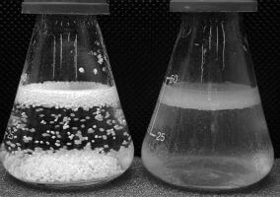
By the end of this lesson you should be able to:
1. | Contrast colloids and solutions.
2. | Contrast colloids and suspensions.

Slide 3
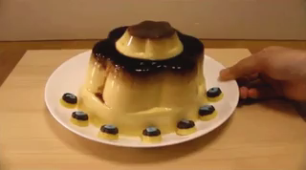
As we have seen with suspensions, mixing an insoluble substance into a solvent creates an unstable mixture that settles out over time.
What if we were able to make a stable suspension from insoluble substances?
Then you would have a colloid.

Slide 4
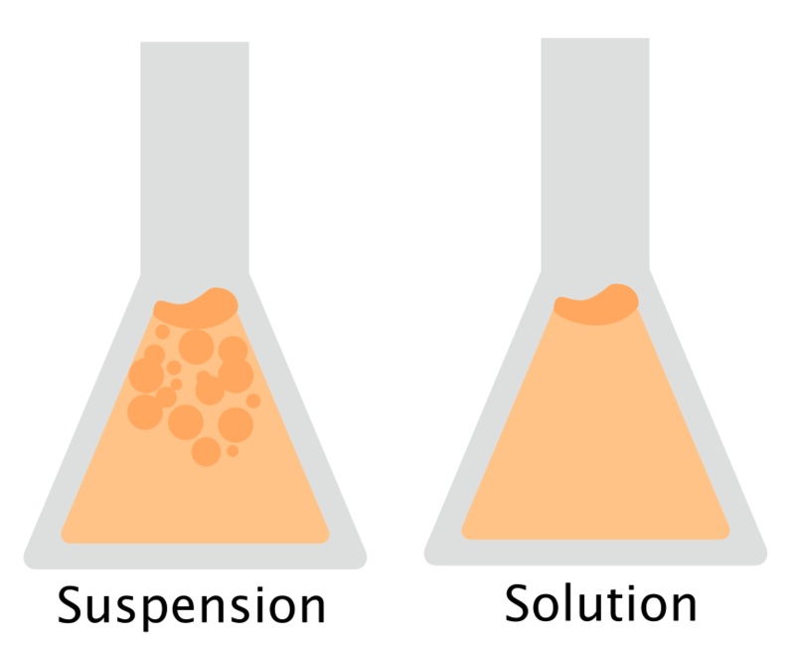
In a suspension, clumps of particles are large, insoluble and settle into layers because of gravity.
In a solution, particles are soluble and fully separate as a solute to make a homogeneous mixture.
Colloids are sort of a cross between a suspension and a solution.

Slide 5
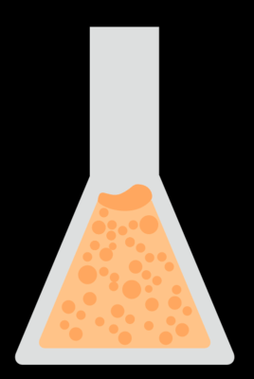
Colloids are the middle ground between solutions and suspensions.
They have insoluble particles that do not dissolve, but instead make tiny clumps that form a homogeneous mixture. The clumps are small enough that they do not settle out, so colloids are stable!

Slide 6
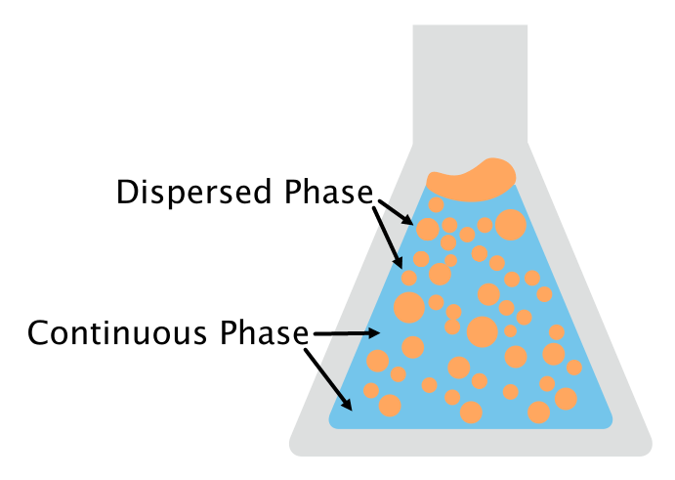
Colloids are made up of two parts: a dispersed phase and a continuous phase.
The dispersed phase is the name given to the suspended clumps that have been spread throughout the mixture.
The continuous phase is the name given to the substance in which the clumps are suspended.
We don't use the terms solute or solvent when talking about colloids, because neither substance has dissolved the other.

Slide 7
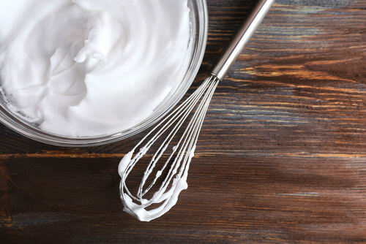
The "clumps" of dispersed phase have a better name: colloidal particles.
They range in size from 1 nanometre to 1000 nanometres. This is very, very small, but they are still much larger than solute particles.
Colloidal particles are spread evenly throughout the continuous phase. Because of this, a colloid is homogeneous.

Slide 8

Colloidal particles tend to make a mixture cloudy, or simply impossible to see through.
Colloidal particles block light.
If you shine a light through a colloid, you will be able to see the light beams inside it. Solutions do not do this, because they are clear.
This is known as the Tyndall effect.

